Slide 1


Slide 2
TRAINING ON TEACHING STRATEGIES FOR HIGHER EDUCATION- 21ST CENTURY
FOR LECTURERS AT PRIVATE UNIVERSITIES IN MOGADISHU
Dr.Said Abubakar Sheikh Ahmed
14/9/2021

Slide 3
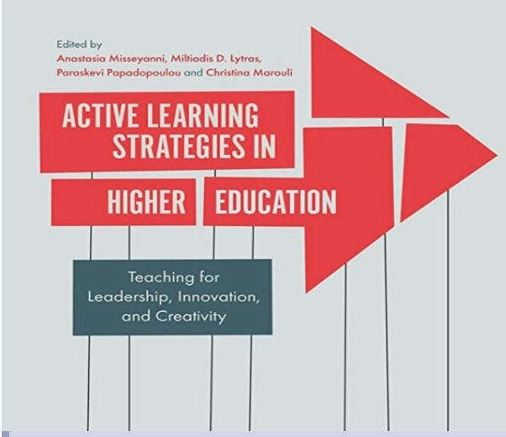

Slide 4
goals and objectives of 21st Century Learning
The goals and objectives of 21st Century Learning can be broken down into 4 categories of skills/literacies

Slide 5
goals and objectives of 21st Century Learning
LIFE AND CAREER SKILLS.
LEARNING AND INNOVATION SKILLS.
INFORMATION, MEDIA & TECHNOLOGY SKILLS.
21ST CENTURY THEMES

Slide 6
21st Century Themes
Global Awareness
Financial, Economic, Business & Entrepreneurial Literacy
Environmental Literacy
Health Literacy
Civic Literacy

Slide 7
LIFE AND CAREER SKILLS.
Psychosocial competence is a person's ability to deal effectively with the demands and challenges of everyday life
Psychosocial Competence Scale (Anita & Vijayalaxmi, 2007): It deals with 10 life skills namely:
PROBLEM SOLVING, DECISION MAKING, CRITICAL THINKING, CREATIVE THINKING, EMPATHY, SELF- AWARENESS, COPING WITH EMOTIONS, COPING WITH STRESS, INTERPERSONAL RELATIONSHIPS AND EFFECTIVE COMMUNICATION

Slide 8
LEARNING
AND
INNOVATION SKILLS.

Slide 9
What are the 4 C's?

Slide 10
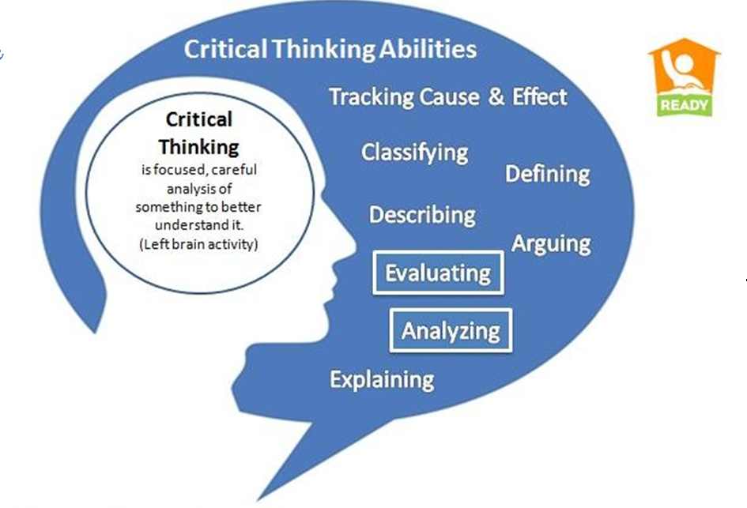
the 4 C's

Slide 11
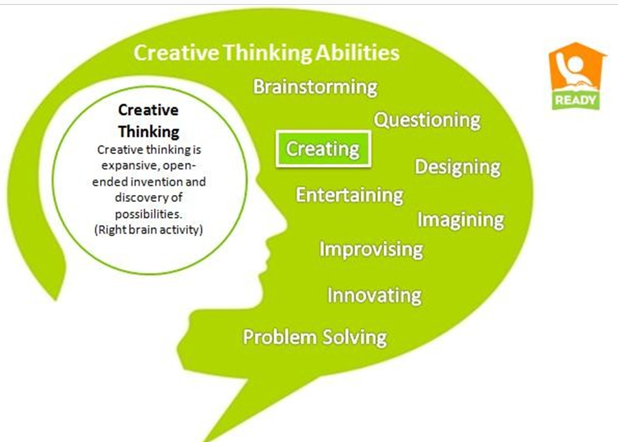
What are the 4 C's?

Slide 12
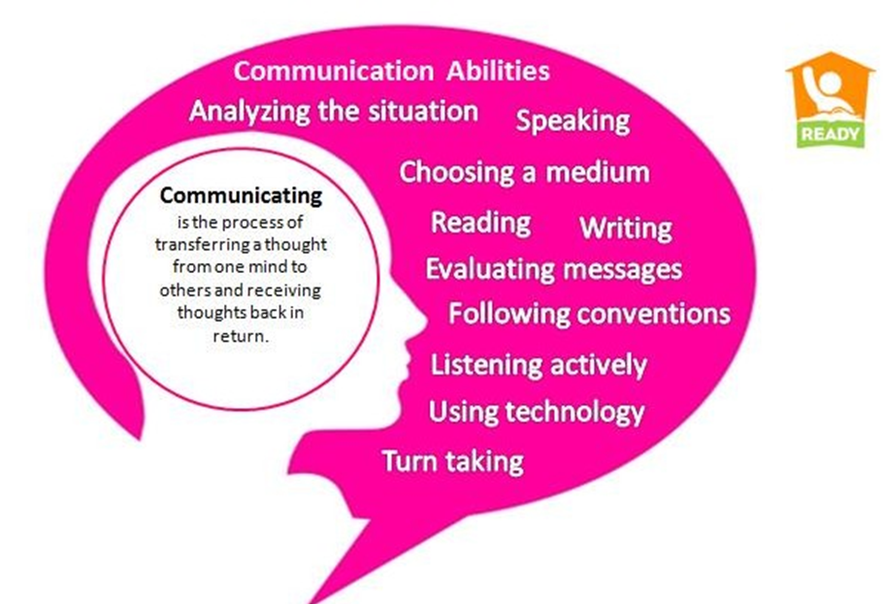
What are the 4 C's?

Slide 13
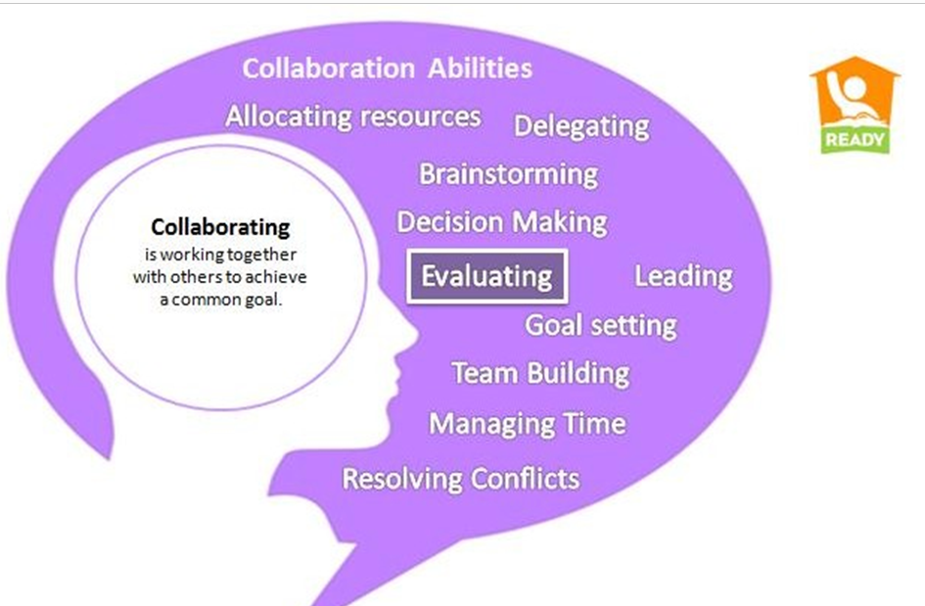
What are the 4 C's?

Slide 14
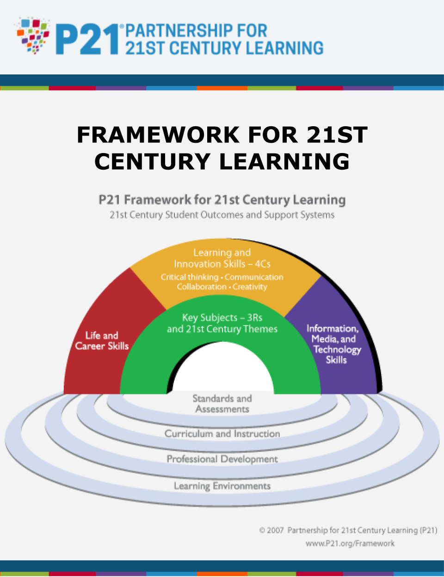

Slide 15
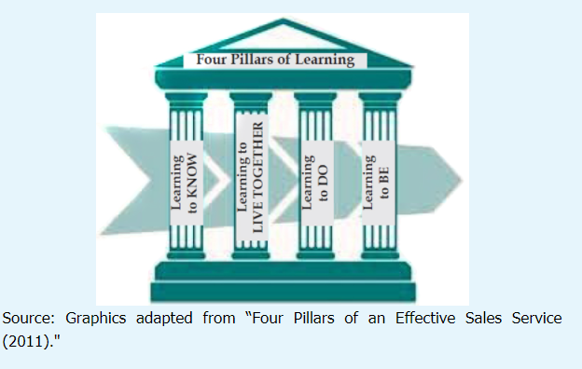
UNESCO FOUR PILLARS OF learning 21st CENTURY

Slide 16
Learning to Know
Learning to Know involves the acquisition and development of knowledge and skills that are needed to function in the world. Examples of skills under this pillar of learning include literacy, numeracy, and critical thinking.

Slide 17
Learning to Live Together
Learning to Live Together involves the development of social skills and values such as respect and concern for others, social and inter-personal skills and an appreciation of the diversity among people. These skills would enable individuals and societies to live in peace and harmony.

Slide 18
Learning to Do
Learning to Do involves the acquisition of skills. These skills are often linked to occupational success, such as vocational and technical skills, apprenticeships, and leadership and management competencies.

Slide 19
Learning to Be
Learning to Be involves activities that promote holistic personal development (body, mind and spirit), for an all-round ‘complete person.’ These include cultivating one’s self analytical and socials skills, creativity, personal discovery and an appreciation of the inherent value provided by these pursuits. An example under this pillar is a teacher who participates in training workshops that will
enhance his/her knowledge and skills in the teaching/learning process.

Slide 20
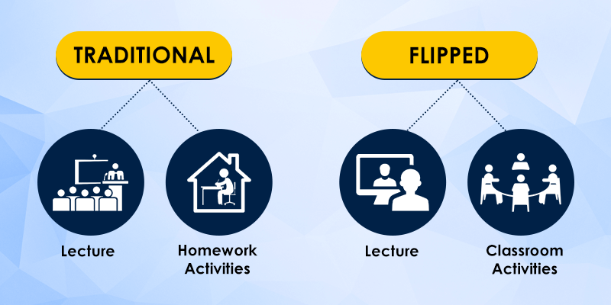
8 methodologies that every 21st century teacher should know 1.flipped classroom

Slide 21

8 methodologies that every 21st century teacher should know
2. PROJECT-BASED LEARNING

Slide 22

8 methodologies that every 21st century teacher should know
3. COOPERATIVE LEARNING

Slide 23
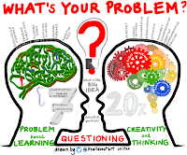
8 methodologies that every 21st century teacher should know
4. PROBLEM-BASED LEARNING

Slide 24

8 methodologies that every 21st century teacher should know
5. THINKING-BASED LEARNING

Slide 25
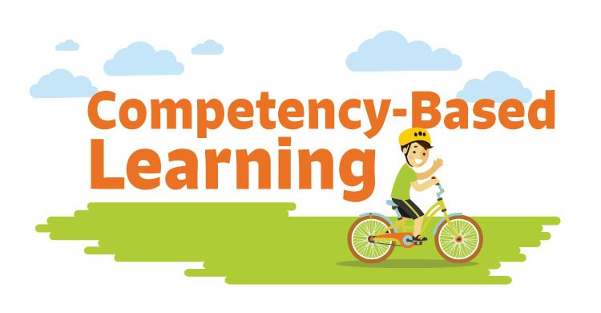
8 methodologies that every 21st century teacher should know
6. COMPETENCY-BASED LEARNING/ OUTCOMES-BASED LEARNING

Slide 26
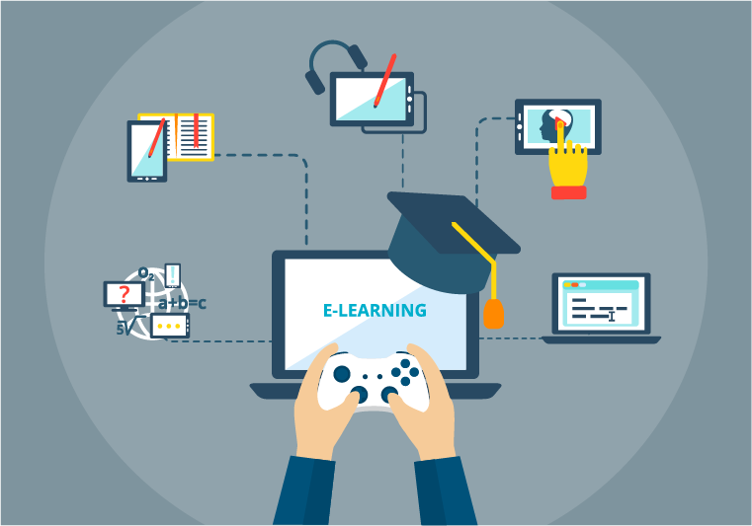
8 methodologies that every 21st century teacher should know
7. GAMIFICATION / VIDEOGAMES IN EDUCATION :Playing educational games to learn academic skills. GAMIFICATION in learning involves using game-based elements such as point scoring, peer competition, team work, score tables to drive engagement, help students assimilate new information and test their knowledge.

Slide 27
8. Design Thinking
8.DESIGN THINKING: IS A MIND-SET AND APPROACH TO LEARNING, COLLABORATION, AND PROBLEM SOLVING. In practice, the design process is a structured framework for identifying challenges, gathering information, generating potential solutions, refining ideas, and testing solutions.

Slide 28
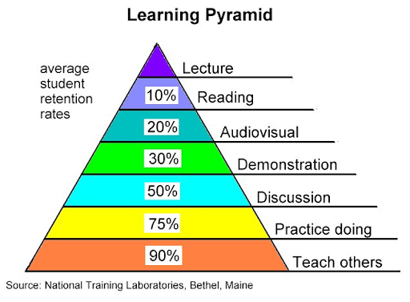
LEARNING PYRAMID

Slide 29
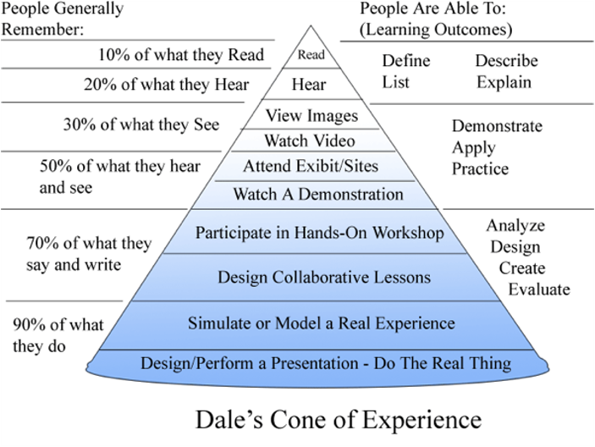
Edgar dale’s cone experience

Slide 30
JIGSAW METHOD/ MODEL OF TEACHING
The jigsaw technique is a method of organizing classroom activity that makes students dependent on each other to succeed. It breaks classes into groups and breaks assignments into pieces that the group assembles to complete the (jigsaw) puzzle.

Slide 31
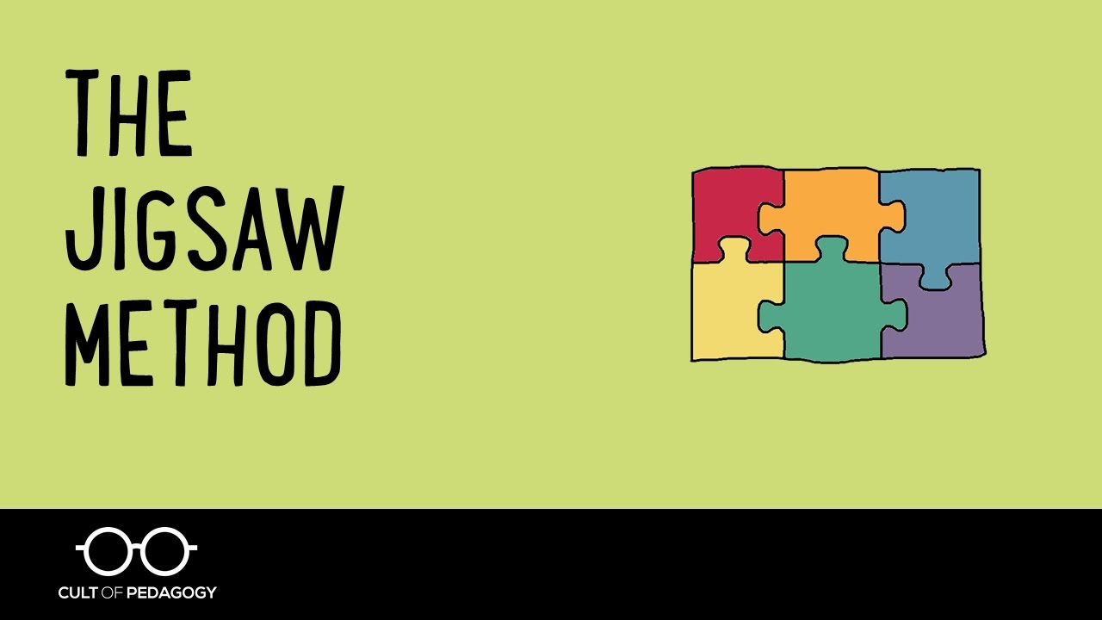
JIGSAW METHOD/ MODEL OF TEACHING

Slide 32
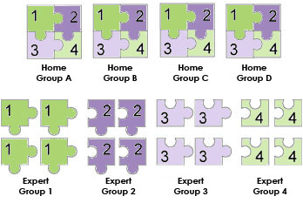
JIGSAW METHOD/ MODEL OF TEACHING

Slide 33
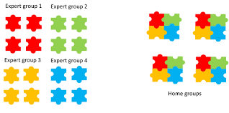
JIGSAW METHOD/ MODEL OF TEACHING

Slide 34
TYPES OF TEACHING METHODS
INSTRUCTOR/TEACHER CENTRED METHODS.
LEARNER-CENTRED METHODS.
CONTENT-FOCUSED METHODS.

Slide 35
SPECIFIC TEACHING METHODS
LECTURE METHOD
THE DISCUSSION METHOD
THE DEMONSTRATION LESSON
BUZZ GROUPS (Description A buzz group is a small group, consisting of three to six people who are given an assignment to complete in a short time period.
BRAINSTORMING.
ROLE PLAYS

Slide 36
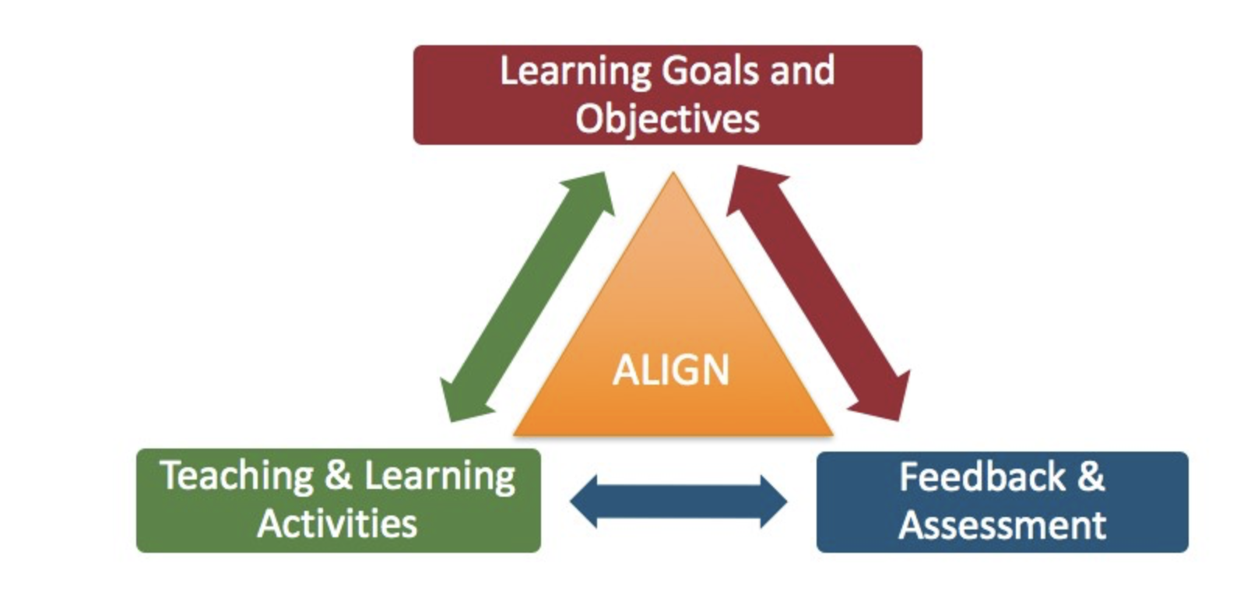
assessments, learning objectives, and instructional strategies

Slide 37
assessments, learning objectives, and instructional strategies
Learning objectives: What do I want students to know how to do when they leave this course?
Assessments: What kinds of tasks will reveal whether students have achieved the learning objectives I have identified?
Instructional strategies: What kinds of activities in and out of class will reinforce my learning objectives and prepare students for assessments?

