Slide 1
ITEM ANALYSIS One-day Training for Secondary Schools Teachers in Mogadishu
Dr.Said Abubakar Sh. Ahmed
26/7/2023

Slide 2
ITEM ANALYSIS
Item analysis is a process of examining class-wide performance on individual test items. There are three common types of item analysis which provide teachers with three different types of information:

Slide 3
Item Difficulty
Item Difficulty Definition: The percentage of students who answered the item correctly.

Slide 4
Difficulty Index
Difficulty Index- Proportion of students who got an item correct. Count the number of students who got the correct answer. Divide by the total number of students who took the test.Difficulty Indices range from .00 to 1.0.

Slide 5
An Example
Number of students who got the correct answer=17,and total number of the student= 30,thus what is the difficult level of the item?
Answer: 17/30=0.56

Slide 6
In general, an item with a difficulty index of 0.5 is considered to be of moderate difficulty, while an item with a difficulty index of less than 0.3 or greater than 0.7 is considered to be either relatively easy or relatively difficult, respectively. The item difficulty index can be used to evaluate the quality of a test item and to make decisions about whether to include it in future tests.

Slide 7
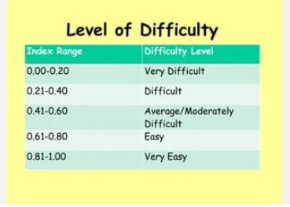
Difficulty Index

Slide 8
Discrimination Index
The Discrimination Index distinguishes for each item between the performance of students who did well on the exam and students who did poorly.

Slide 9
Discrimination Index
For each item, subtract the number of students in the lower group who answered correctly from the number of students in the upper group who answered correctly.
Divide the result by the number of students in one group.
The Discrimination Index is listed in decimal format and ranges between -1 and 1

Slide 10
Discrimination Formula
The discrimination index was calculated using the formula D=(UG-LG) / n.
D = Discrimination level
UG = Upper group
LG = Lr group
N = Number of one group

Slide 11
Another Formula
For each group, calculate a difficulty index for the item.
Subtract the difficulty index for the low scores group from the difficulty index for the high scores group.
Imagine this information for our example: 10 out of 13 students (or tests) in the high group and 6 out of 12 students in the low group got the item correct.

Slide 12
An Example
Imagine this information for our example: 10 out of 13 students (or tests) in the high group and 6 out of 12 students in the low group got the item correct.
High Group 10/13= .77
Low Group 6/12= .50
.77-.50=.27

Slide 13
The item discrimination index can be used to evaluate the quality of a test item and to make decisions about whether to include it in future tests.

Slide 14
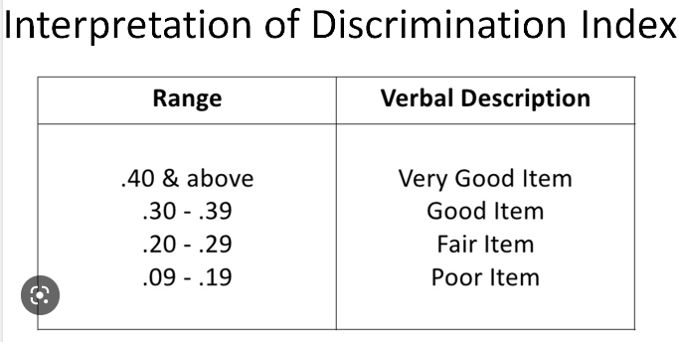
DISCRIMINATION INDEX

