Slide 1
STEPS OF TEST CONSTRUCTION One-day Training for Secondary Schools Teachers in Mogadishu
DR.SAID ABUBAKAR
25/7/2023

Slide 2
STEPS OF TEST CONSTRUCTION
Planning of the test
This entails preparation of an outline which should be derived from the course content to be covered by the test. Care should also be taken on the issue of item difficulty, type of items, number of items and directions to be followed.

Slide 3
SPECIFICATION OF OBJECTIVES
This is the first steps of test construction. This area is very important for you as a teacher. As you are aware, there is no single day when you will go to each without an objective. Lack of this will brand you an unguided teacher.

Slide 4
ROLE OF OBJECTIVES IN EVALUATION CURRICULUM
Objectives are the behaviors that are to be exhibited if the aims of the course are attained. Lesson objectives are the intended outcomes of the lesson. These definitions show that objectives:
1. Should be stated before a course or a lesson is taught.
2. State the intended achievement of the learners.
3. Therefore give us information about the nature of the person we intend to see after the course or the teaching/learning process.
Owing to these, we can now look at the roles of objectives in evaluation.

Slide 5
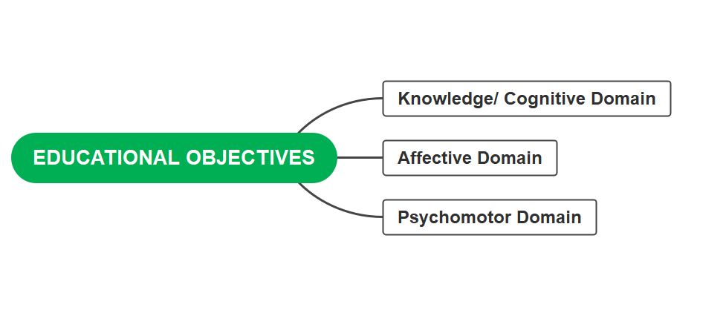
EDUCATIONAL OBJECTIVES
There are three domains of educational objectives (Bloom taxonomy) which are:

Slide 6
KNOWLEDGE OBJECTIVES
According to Benjamin Bloom, educational objectives in cognitive domain (knowledge domain) should represent a hierarchy of six levels. Let us look at these levels and how they guide the evaluator.

Slide 7
KNOWLEDGE
This is the lowest level of learning outcomes in the cognitive domain. This level requires that you ensure children’s acquisition of facts and help them to deal with specific concepts and principles in learning. ACTION VERBS OF THIS LEVEL: DEFINE, LIST, NAME ,STATE ,POIN OUT

Slide 8
COMPREHENSION
To comprehend is to grasp the meaning of material. Objectives at this level reflect the learners’ understanding of facts and principles, interpretation , charts, graphs, maps, illustrations, etc. .In evaluation we have to check the existence of these comprehension abilities in the learner. ACTION VERBS OF THIS LEVEL( EXPLAIN, DISCUSS, COMPARE, GIVE AN EXMPLE)

Slide 9
APPLICATION
Some objectives should state the learners’ ability to apply the learnt material .To show that what you have taught has been understood, it has to be applied. ACTION VERBS OF THIS LEVEL (APPLY,PREPARE ,PRODUCE,SOLVE ,DEMONSTRATE)

Slide 10
ANALYSIS
Analysis refers to the learner’s ability to break down material into its component parts so that its structure can be understood. For your students to be able to analyze, you need to help them to understand the component parts of content in order to understand its structure.
ACTION VERBS OF THIS LEVEL (CATAGORIZE,CLASSIFY,ANALYZE DIFFERENTIATE ,DESTINGUISH)

Slide 11
SYNTHESIS/CREATE
After helping children to understand the component parts of content, you need to help together the component parts. Learners have to determine interrelationships between component parts of content. ACTION VERBS OF THIS LEVEL
(CONSTRUCT ,CREATE,DESIGN, ONGANIZE, MAKE UPP)

Slide 12
EVALUATION
At this level, you need to evaluate the learners’ ability to present logical consistency of written material, adequately make conclusions and summaries which are supported by available information. ACTION VERBS OF THIS LEVEL ( ASSESS,APPRAISE, JUDGE, CRITICIZE,DEFEND)

Slide 13
STEP 2 CONTENT ANALYSIS:
It is to identify topics of the content and items of every topic to be represented in test items in accordance with length of units/topics.

Slide 14
STEP 3 PREPARATION OF SPECIFICATION TABLE
There are steps of preparation of specification table as the following:
Designing specification table.
Determining the percentage (concentration ratio) for each topic of content, where the concentration ratio = number period of each topic÷ total period of subject× 100.
Determining the percentage (concentration ratio) for each topic of content, where the concentration ratio = number pages of each topic÷ total pages of subject /book × 100.
Determining the percentage of objectives for each topis/unit, where the concentration ratio = number objectives of each topic /unit÷ total objectives x100.
Determining the percentage of the six objectives of cognitive domain,this depends on teacher‘s experience.
Determining the number of test questions..

Slide 15
SPECIFICATION TABLE (Number of items 30) An example : 0.3 of unit one x 0.3 of remembering x 30 of number of questions=2.7
UNITS /OBJECTIVES | REMEMBERING 30% | UNDERSTANDING30% | APPLYING 15%% | ANALYSING 10% | EVALUATING 10% | SYNTHESIZING 5% | Total
Unit 0ne 30% | 2.7 | 2.7 | 1.3 | 0.9 | 0.9 | 0.05
Unit Two 40% | 3.6 | 3.6 | 1.8 | 1.2 | 1.2 | 0.06
Unit Three 20% | 1.8 | 1.8 | 0.9 | 0.6 | 0.6 | 0.3
Unit Four 10% | 0.9 | 0.9 | 0.4 | 0.3 | 0.3 | 0.15
Total

